Slide 1
Advancing Frontiers of Energy Forecasting with Novel Methods
Can a forecast tell you when to stop trusting it?
Jonathan Fuentes Rosales
Mentor: John Brewer | Federal Team Supervisor: Luciane Cunha
Science Undergraduate Laboratory Internship (SULI), Summer 2026
National Energy Technology Laboratory | U.S. Department of Energy
Notes:
0:00–0:20. Name, mentor, supervisor, program.

Slide 2
Disclaimer
This project was supported in part by the U.S. Department of Energy, Office of Science, Office of Workforce Development for Teachers and Scientists (WDTS), under the Science Undergraduate Laboratory Internships (SULI) Program through an appointment at the National Energy Technology Laboratory (NETL). Neither the United States Government nor any agency thereof, nor any of its employees, nor the support contractor, nor any of their employees, makes any warranty, express or implied, or assumes any legal liability or responsibility for the accuracy, completeness, or usefulness of any information, apparatus, product, or process disclosed, or represents that its use would not infringe privately owned rights. Reference herein to any specific commercial product, process, or service by trade name, trademark, manufacturer, or otherwise does not necessarily constitute or imply its endorsement, recommendation, or favoring by the United States Government or any agency thereof. The views and opinions of authors expressed herein do not necessarily state or reflect those of the United States Government or any agency thereof.
Notes:
Mandatory, and must precede any technical content. Text is verbatim from the supplied NETL template. Do not linger — read the slide title aloud and move on.

Slide 3
Motivation
Why accurate energy forecasting matters to the DOE mission
Electricity cannot be stored at grid scale, so supply and demand must be matched every second — which means someone must forecast tomorrow's demand today.
That forecast is a bet with two ways to lose. Too low, and there is not enough power when people need it. Too high, and customers pay for generators that sat idle.
Operators can hedge by committing generation early, ahead of the market. That is insurance, and it costs money — so whether it is worth buying depends entirely on how much the forecast's uncertainty can be trusted.
February 2021: forecasts missed, reserves fell short, and ERCOT cut power to paying customers.
Notes:
0:20–2:00. Make it physical. Storage is the constraint; the two-sided cost is the job. Land on: trusting the uncertainty is what the hedge decision rests on. That's the thread for the talk.

Slide 4
Background: Conventional Forecasting and Its Limits
Where existing approaches fall short
Current practice. Day-ahead load forecasting relies on statistical and machine-learning models fitted to long histories of ordinary operation, assuming the relationship between weather and demand is stable.
Known limitation 1 — the assumption breaks in extremes. During severe cold, that relationship shifts, so ordinary days actively mislead.
Known limitation 2 — the extreme days are scarce. Twenty-four years of ERCOT data contain seventeen usable extreme cold events. A model with thousands of ordinary days has almost nothing to learn from for the days that decide whether the grid holds.
The gap this project addresses: whether a method designed for learning from few examples helps in exactly that regime.
Notes:
2:00–3:40. The 17-events number is the constraint everything else follows from — say it slowly and let it land.

Slide 5
Research Objectives
The specific question this project set out to answer
Research question. A 2026 paper proposes AdaCNP — a model that forecasts by referring to similar past days, learning to weight past freezes more heavily than past Tuesdays. It was demonstrated on the PJM and ISO-NE grids. Does that advantage hold on Texas?
Objectives
1. Rebuild the method and a standard baseline, and evaluate both on held-out ERCOT extreme cold events.
2. Fix the measurement, the statistical test and the success threshold in advance, committed to version control before running the experiment.
3. Establish what a study of this size can and cannot detect.
Scope. Two models, one comparison, retrospective data. Nothing was deployed operationally.
Notes:
3:40–5:10. The pre-registration line is the most trustworthy thing you can say: 'I wrote down what would count as success before I looked at the answer.' One sentence, then move.

Slide 6
Data and Methods
What went in, what was used, and how it was evaluated
Data. Hourly ERCOT system load, 2002–2026, adopted by content hash. Seventeen load-eligible extreme cold events, defined by a regional temperature index. Inputs are calendar terms, 24 hours of recent load, and 24 hours of recent temperature — 57 features.
Guarding against cheating. Each event is held out in turn, with a seven-day buffer on each side excluded from both training and retrieval. Only information available by 09:00 the previous day may enter a forecast. Both models receive byte-identical context sets.
Evaluation. Probabilistic score (Gaussian negative log likelihood) against the standard-CNP baseline, paired within each event, averaged over three random seeds. 408 training runs in total.
Notes:
5:10–6:20. Don't explain neural processes architecturally. The leakage controls are worth 20 seconds — they're why the result is credible.

Slide 7
Approach
End-to-end workflow from raw data to validated result
1. Verify and import the data by content hash, so provenance is exact.
2. Define episodes: predict one day's 24-hour load from information available at the previous morning's cutoff.
3. Hold out one extreme event at a time, with buffers excluded from training and from the pool of reference days.
4. Pre-register the analysis — endpoint, test, threshold and decision rule committed before any confirmatory run.
5. Run the full sweep: 17 events × 2 models × 3 seeds × 2 feature sets × 2 reference-selection methods = 408 runs.
6. Apply the pre-registered test exactly as written, and report what it could not have detected alongside what it did.
Notes:
6:20–7:00. Move briskly. Step 4 is the one that matters.

Slide 8
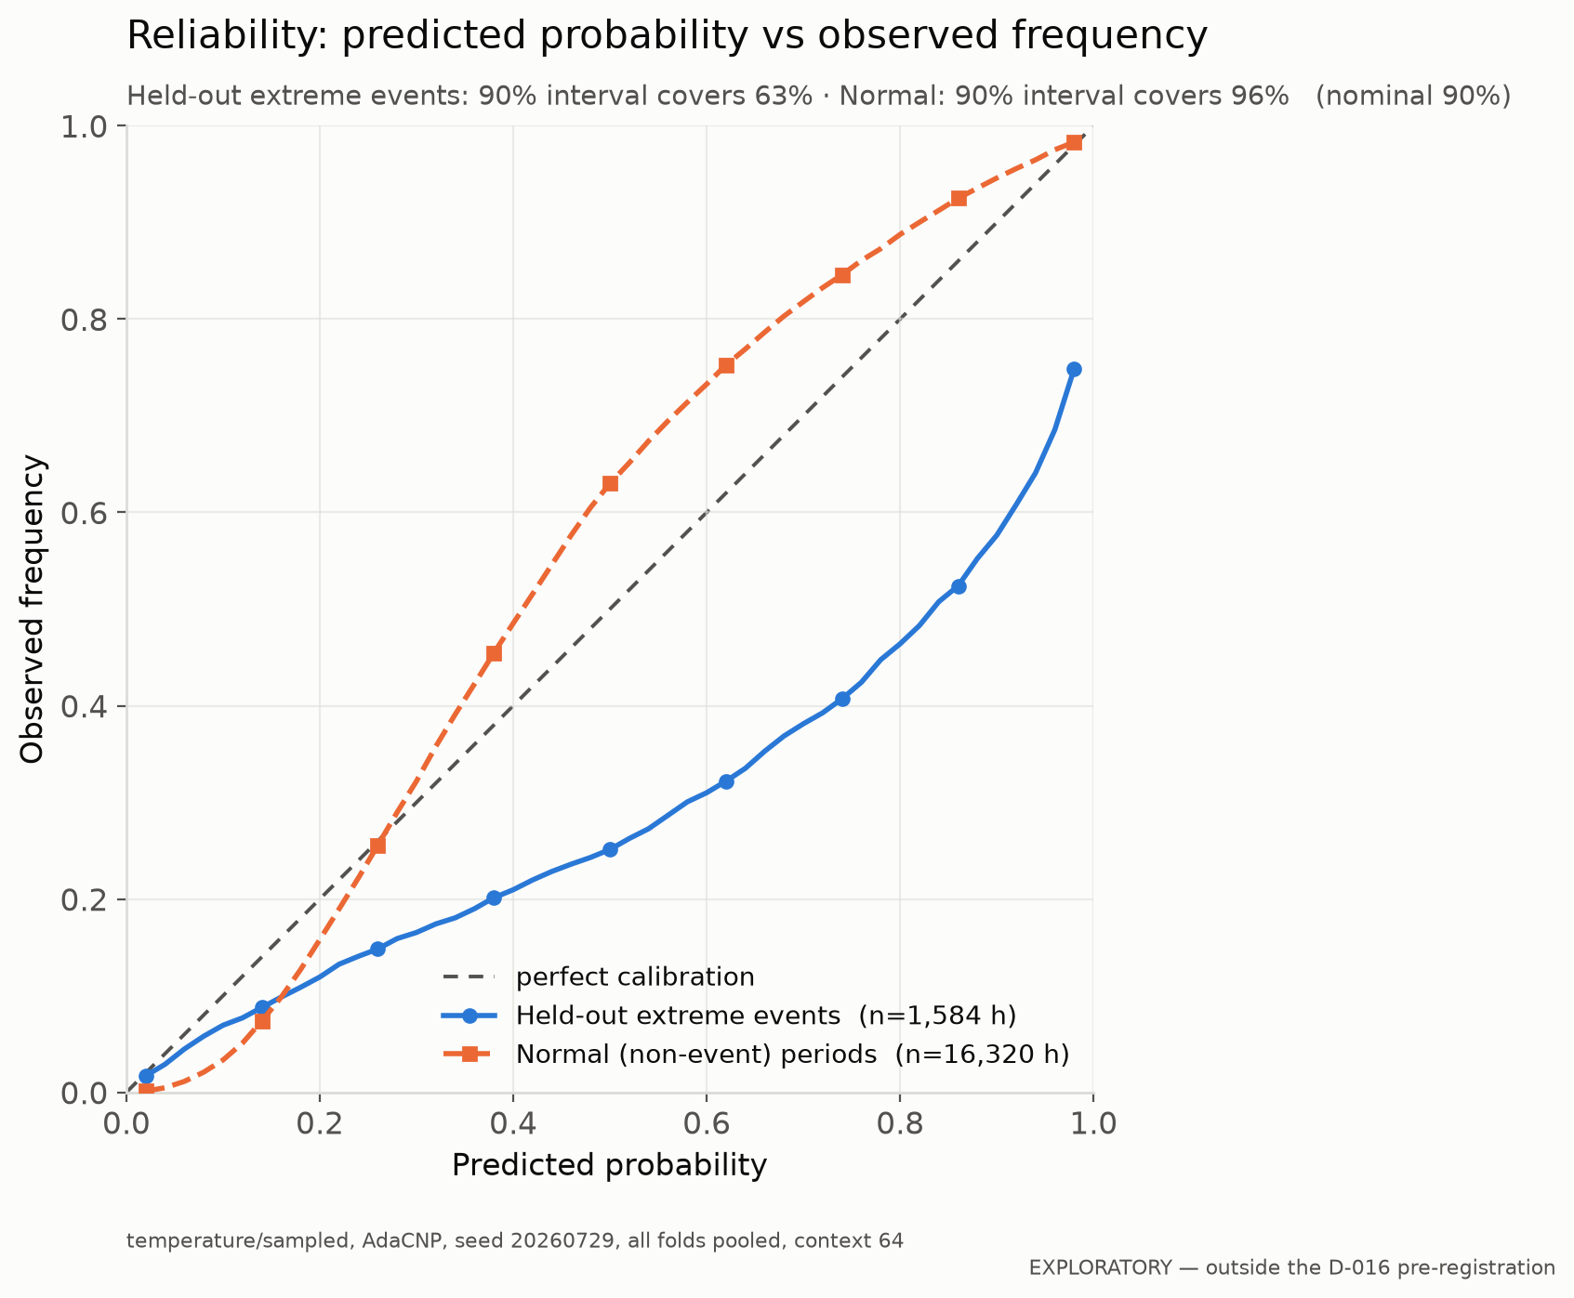
Results I: The forecasts are confidently wrong when it matters
Measured on held-out extreme events, not placeholder data
A “90% confidence” range should contain the real load 9 times in 10. On normal days it contains it 96% of the time. During extreme cold events, 63% — and the curve sits below the line, meaning real demand runs higher than the model expects.
Exploratory analysis
Notes:
7:00–8:15. THE headline for this audience. Two numbers: 96 and 63. Then the direction — confidently wrong, and wrong the dangerous way. This is the slide to slow down on.

Slide 9
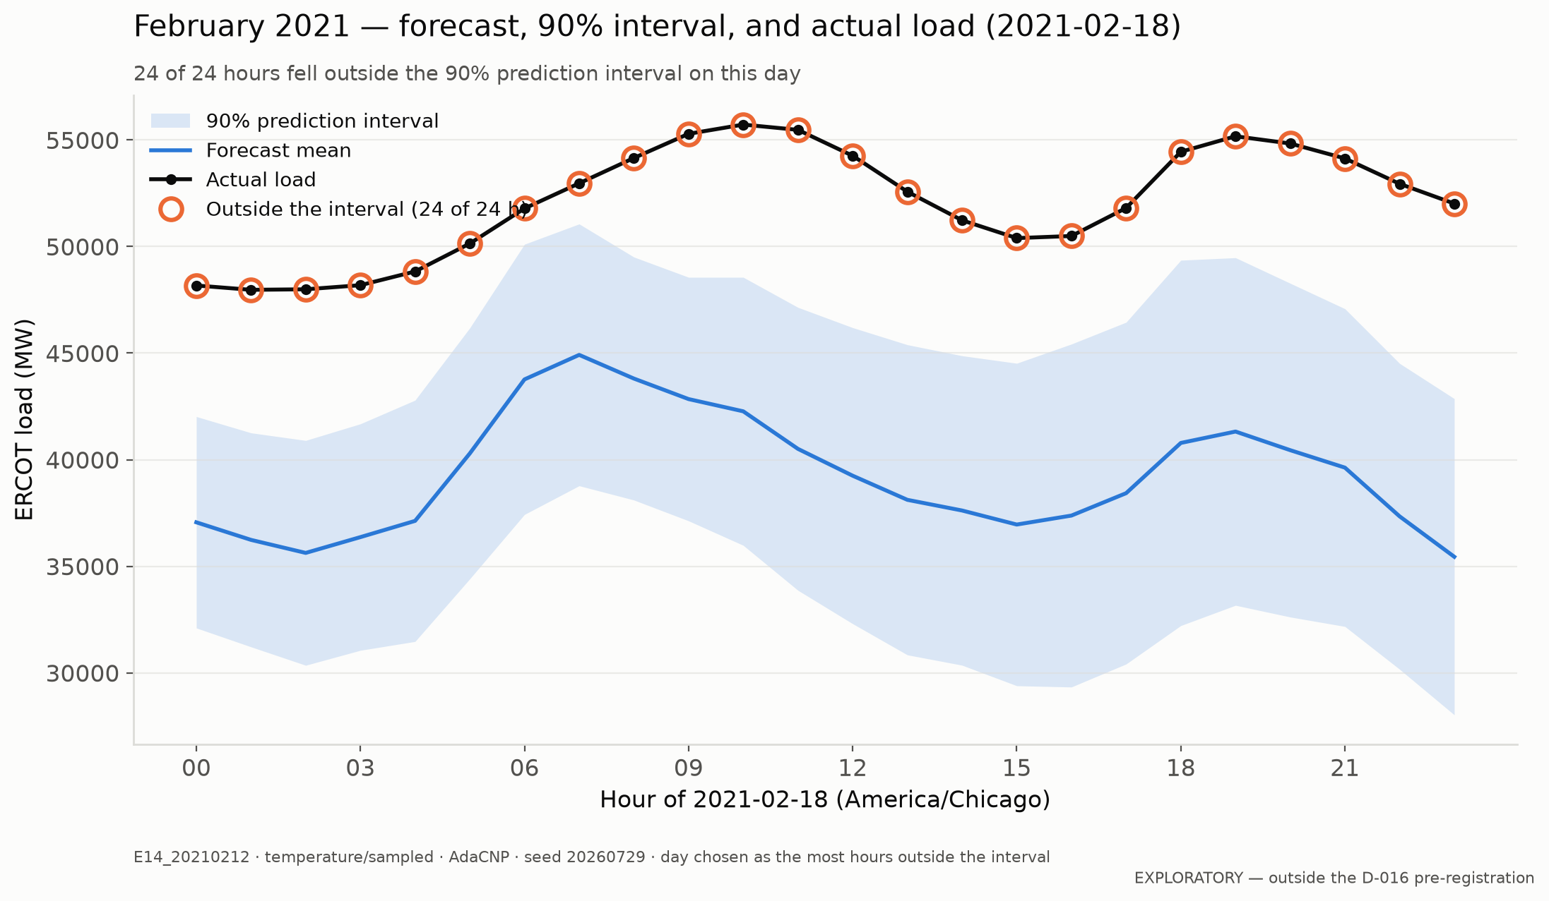
Results II: Predicted vs. Observed Demand
One day of the February 2021 event
2021-02-18: all 24 of 24 hours fell outside the 90% range, with real demand roughly 10 GW above the forecast. No load shedding occurred that day — this is forecast error, not curtailed demand.
Exploratory · worst day of that event, selected by a stated rule
Notes:
8:15–8:50. Concrete. Be honest that it's the worst day chosen by a rule — the honesty is worth more than the drama.

Slide 10
Discussion
What the results mean — and what they do not
The method did help. AdaCNP beat the baseline on the pre-registered test: +0.46 in the primary score, 95% CI [+0.11, +0.81], p = 0.014, across all 17 events.
Three things that must be said with it. The effect is right at the edge of what 17 events can resolve — about 77% power at the size found. It appears only in the configuration committed in advance; another configuration favoured the baseline. And it is not the effect size the original paper reported — detecting that would need several hundred events, and Texas has seventeen.
A puzzle. The method is supposed to work by attending to similar past days. Measured directly, it does the opposite: 7.9% of its attention on cold past days, where uniform weighting would give 10.5%.
Notes:
8:50–9:40. Result, then caveats, undiluted. The caveats are why the result is believable. The mechanism puzzle is a 15-second aside — don't over-explain it.

Slide 11
Conclusions and Future Work
Key takeaways from the summer and where the work goes next
Key findings. The method helps, modestly and near the detection limit. More consequentially, both models are badly overconfident during extreme events, and predictably so — calibration degrades as the cold deepens.
Impact. A forecast that is uncertain and says so is manageable. A forecast that is wrong and confident is what makes an operator skip the expensive hedge. Because the unreliability is predictable, a model can flag when its own range should not be trusted — directly usable for an early-commitment decision.
Future work. Fix calibration before changing architecture; acquire day-ahead forecast weather; broaden the event definition to raise the sample size.
Notes:
9:40–10:00. Land on the 'uncertain and says so' line, then stop and take questions.

Slide 12
Acknowledgments
Thank you — questions welcome
With thanks to
John Brewer — NETL, for project guidance and mentorship
Luciane Cunha — Federal Team Supervisor
[Add colleagues or group members who contributed]
Support. This work was supported in part by the U.S. Department of Energy, Office of Science, Office of Workforce Development for Teachers and Scientists (WDTS), under the Science Undergraduate Laboratory Internships (SULI) program.
Questions? [add your email]
Notes:
Q&A slide — leave it up for the 5-minute question period.

Slide 13
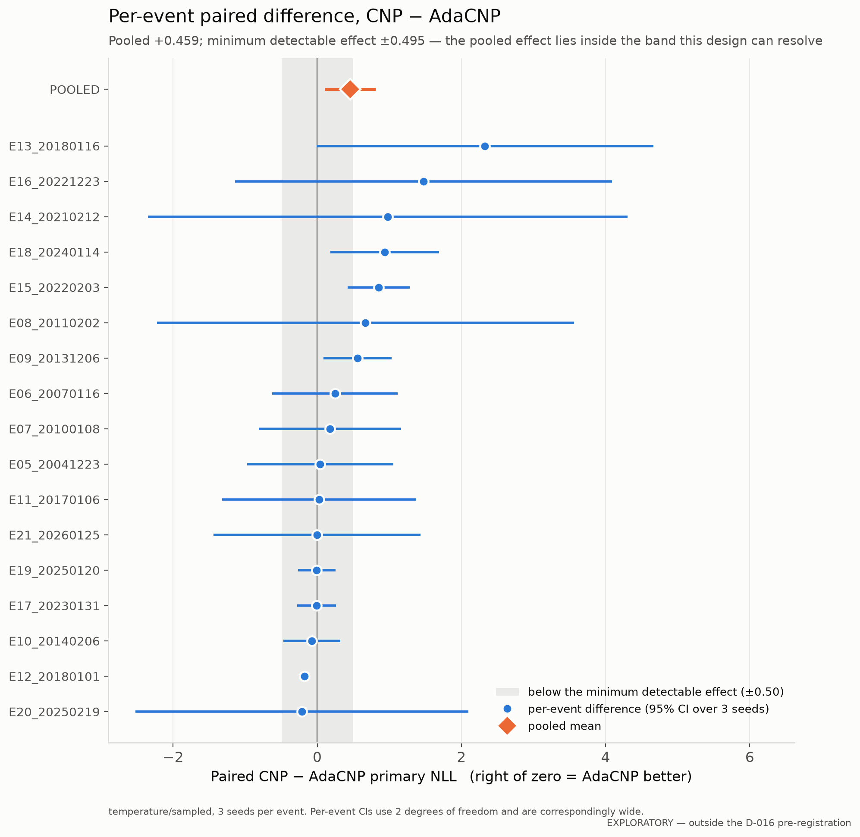
Backup: per-event results
Exploratory · backup, not part of the 10-minute talk
Notes:
Q&A: 'did one event drive it?' No — leaving any single event out keeps the sign, and 11 of 17 favour AdaCNP.

Slide 14
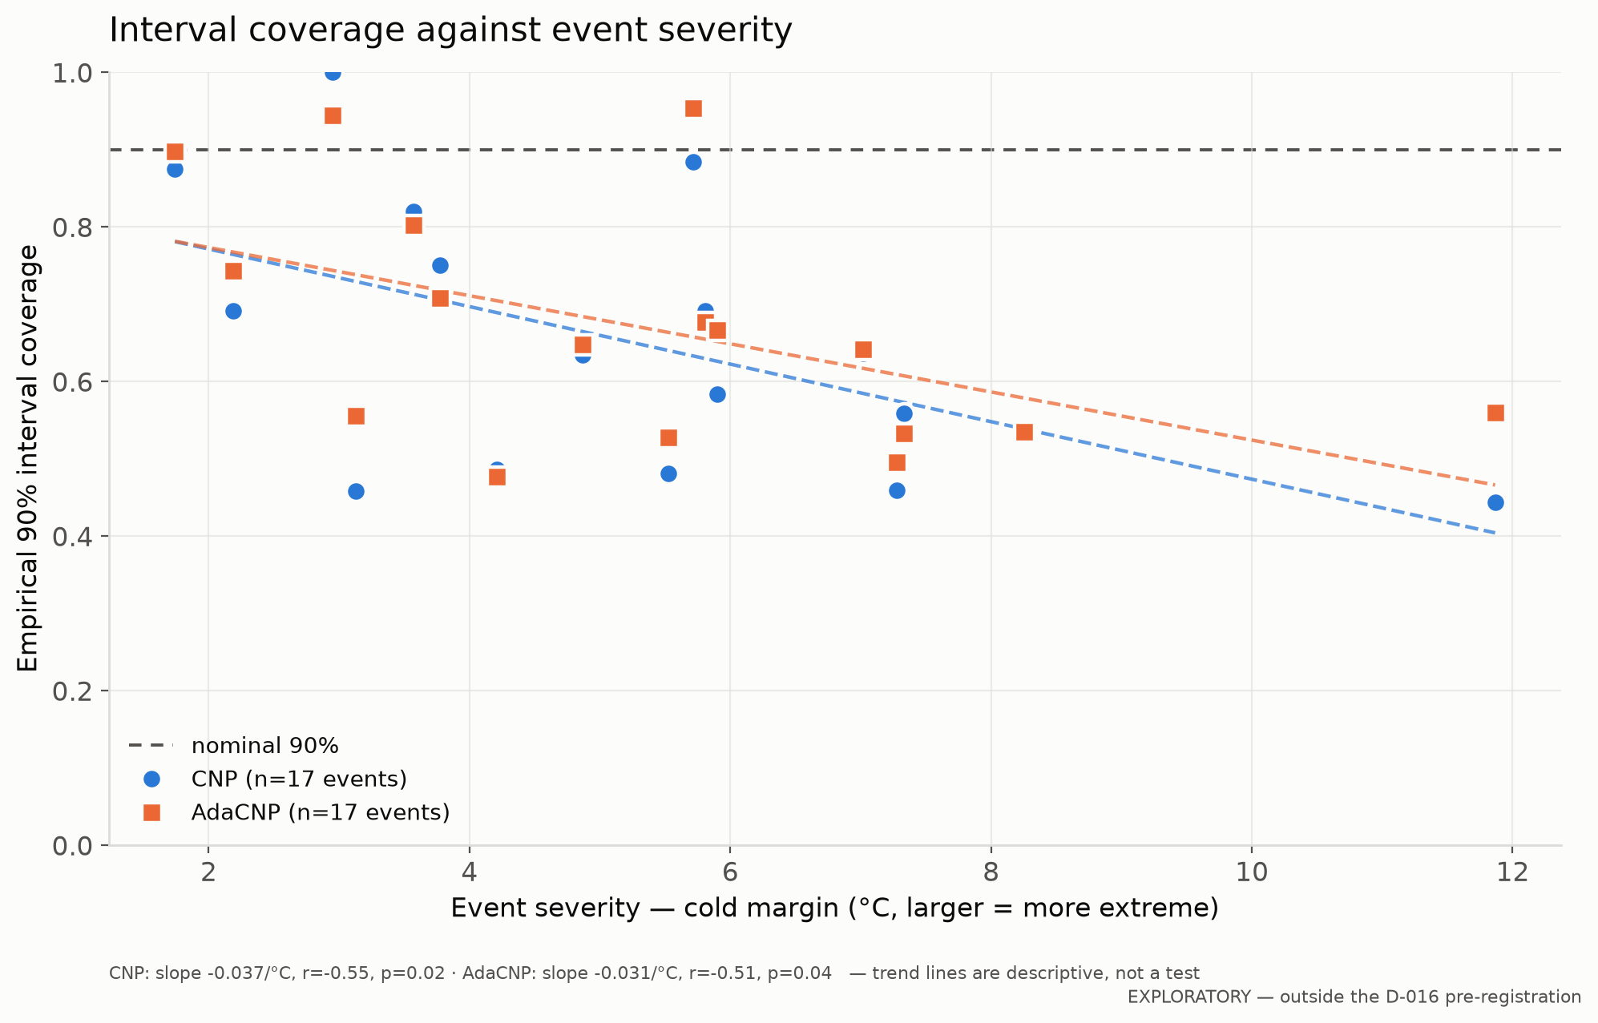
Backup: calibration vs. event severity
Exploratory · backup, not part of the 10-minute talk
Notes:
Q&A: 'is it worse for bigger events?' Yes — about 3.5 percentage points of coverage lost per degree C of cold margin.

